Slide 1


Handwritten Text Recognition
Project Work – 1 Report

Slide 2
Team Members
Avinash Kumar
EN19CS301084
Arushi Jain
EN19CS301076
Dhananjay Porwal
EN19CS301110
Under the Guidance of Prof. Snehal Moghe ma’am

Slide 3
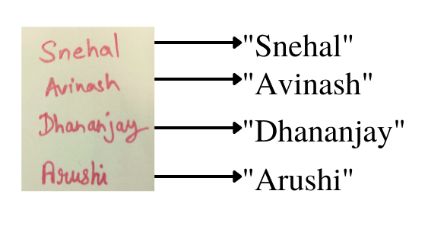
Handwritten Text Recognition
Handwritten Text Recognition (HTR) systems transcribe text contained in scanned images into digital text.
We will build a Neural Network (NN) which is trained on word images from the IAM dataset.
Below illustration shows a sample of our model input and output:

Slide 4
Problem Statement
People make notes on pen and paper. Everyone does not have the access to products through which they can create handwritten notes in a digital file. They have to manually type the written notes into a digital file. It is a very cumbersome process as it wastes manpower and time.
There is no good software till date which can convert more than 1 image in digital form at a time.
Bad Handwriting is a major issue for creating such models. Because most of the ML model can recognize good handwriting but it is quite difficult to predict in bad handwriting.

Slide 5

Why this?
Better Word Search
1
2
Convert in bulk
Adaptive Interface
3

Slide 6

TECHNOLOGY USED

Slide 7
NEURAL NETWORKS
01

Slide 8

Neural Networks
A neural network is a method in artificial intelligence that teaches computers to process data in a way that is inspired by the human brain. It is a type of machine learning process, called deep learning, that uses interconnected nodes or neurons in a layered structure that resembles the human brain. It creates an adaptive system that computers use to learn from their mistakes and improve continuously. Thus, artificial neural networks attempt to solve complicated problems, like summarizing documents or recognizing faces, with greater accuracy.

Slide 9
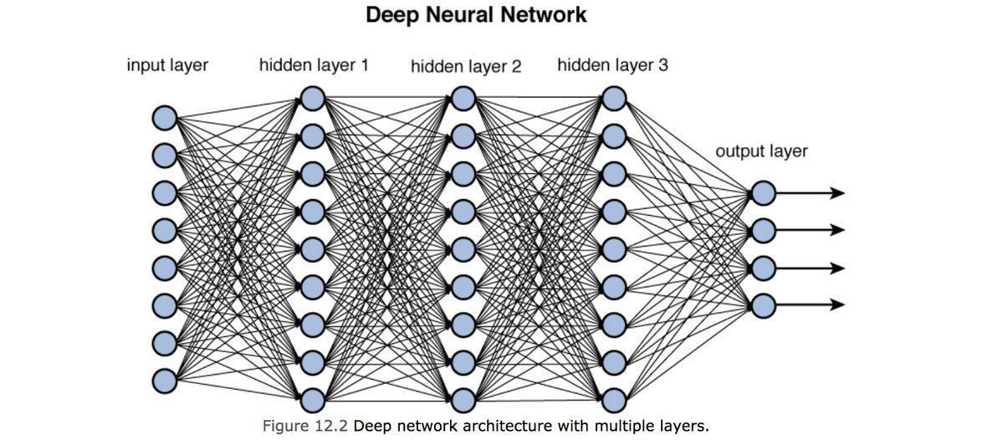

Slide 10
DIMENTIONALITY REDUCTION
02

Slide 11
Dimensionality Reduction
In machine learning classification problems, there are often too many factors on the basis of which the final classification is done. These factors are basically variables called features. The higher the number of features, the harder it gets to visualize the training set and then work on it. Sometimes, most of these features are correlated, and hence redundant. This is where dimensionality reduction algorithms come into play. Dimensionality reduction is the process of reducing the number of random variables under consideration, by obtaining a set of principal variables. It can be divided into feature selection and feature extraction.

Slide 12
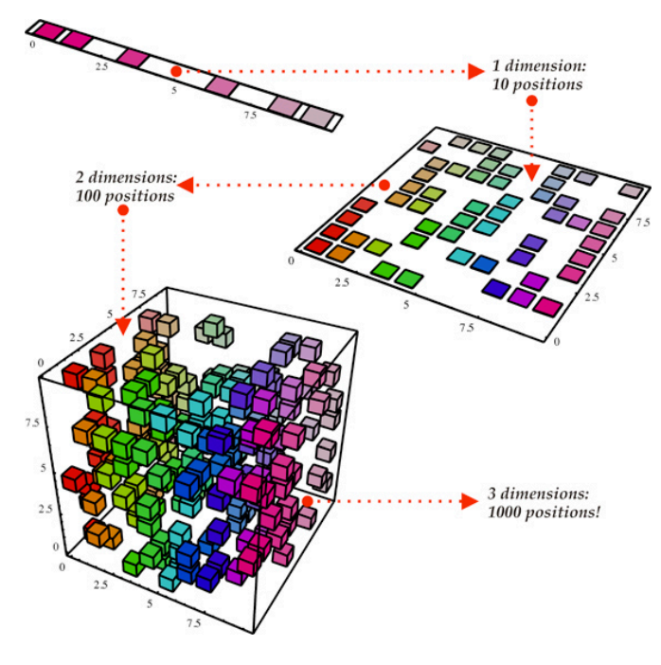

Slide 13
GIT & GITHUB
03

Slide 14
GIT & GITHUB
The idea of Git is a little intimidating at first but embodies a very simple idea. As described on its website, Git is essentially a free and open source distributed version control system designed to handle everything from small to very large projects with speed and efficiency.
It allows groups of developers to collaborate on the same documents (often source code) simultaneously and without overriding each other’s work.
GitHub is an Internet hosting service for software development and version control using Git.

Slide 15



Slide 16
DOCKER
04

Slide 17

DOCKER
Docker is an open platform for developing, shipping, and running applications. Docker enables you to separate your applications from your infrastructure so you can deliver software quickly. With Docker, you can manage your infrastructure in the same ways you manage your applications. By taking advantage of Docker’s methodologies for shipping, testing, and deploying code quickly, you can significantly reduce the delay between writing code and running it in production.

Slide 18
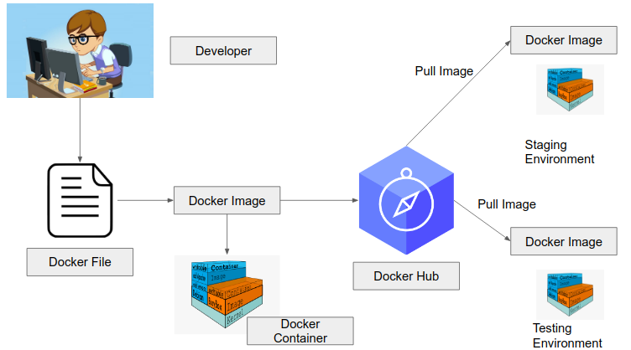

Slide 19
STREAMLIT
05

Slide 20

STREAMLIT
Streamlit turns data scripts into shareable web apps in minutes. All in pure Python. No frontend experience required. The core benefit of a tool like Streamlit is that it is Python based. Many of the insight graphs, evaluation graphs, and prediction graphs have already been created by data scientists during model development. This usually happens in the form of Jupyter notebooks. Moving the code to generate these visualizations into a Streamlit dashboard requires little work. Streamlit allows you to re-use any Python code you have already written. This can save considerable amounts of time compared to non-Python based tools where all code to create visualizations needs to be re-written.

Slide 21
MODEL OVERVIEW

Slide 22
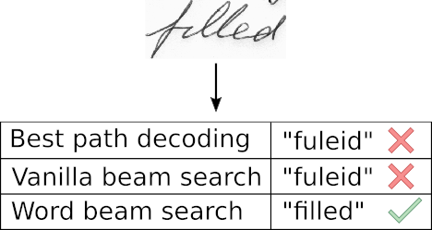
MODEL OVERVIEW
We use a NN for our task. It consists of convolutional NN (CNN) layers, recurrent NN (RNN) layers and a final Connectionist Temporal Classification (CTC) layer. It shows an overview of our HTR system.
We can also view the NN in a more formal way as a function (see Eq. 1) which maps an image (or matrix) M of size W×H to a character sequence (c1, c2, …) with a length between 0 and L. As you can see, the text is recognized on character-level, therefore words or texts not contained in the training data can be recognized too (as long as the individual characters get correctly classified).

Slide 23
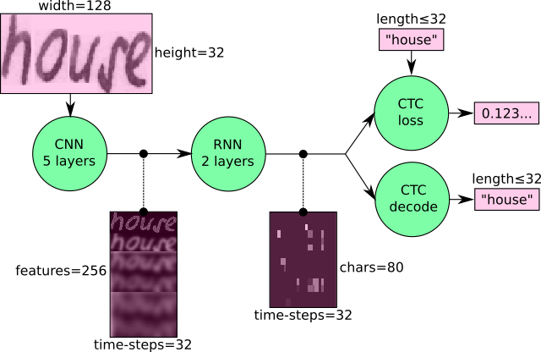

Slide 24
DEPLOYMENT

Slide 25
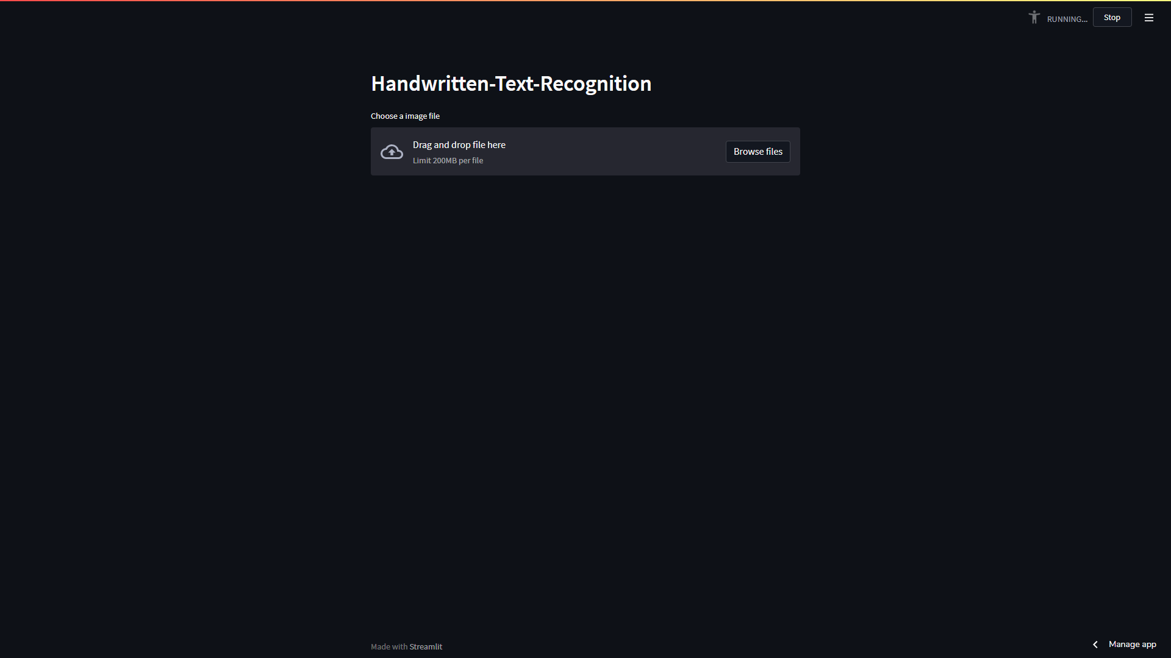

Slide 26
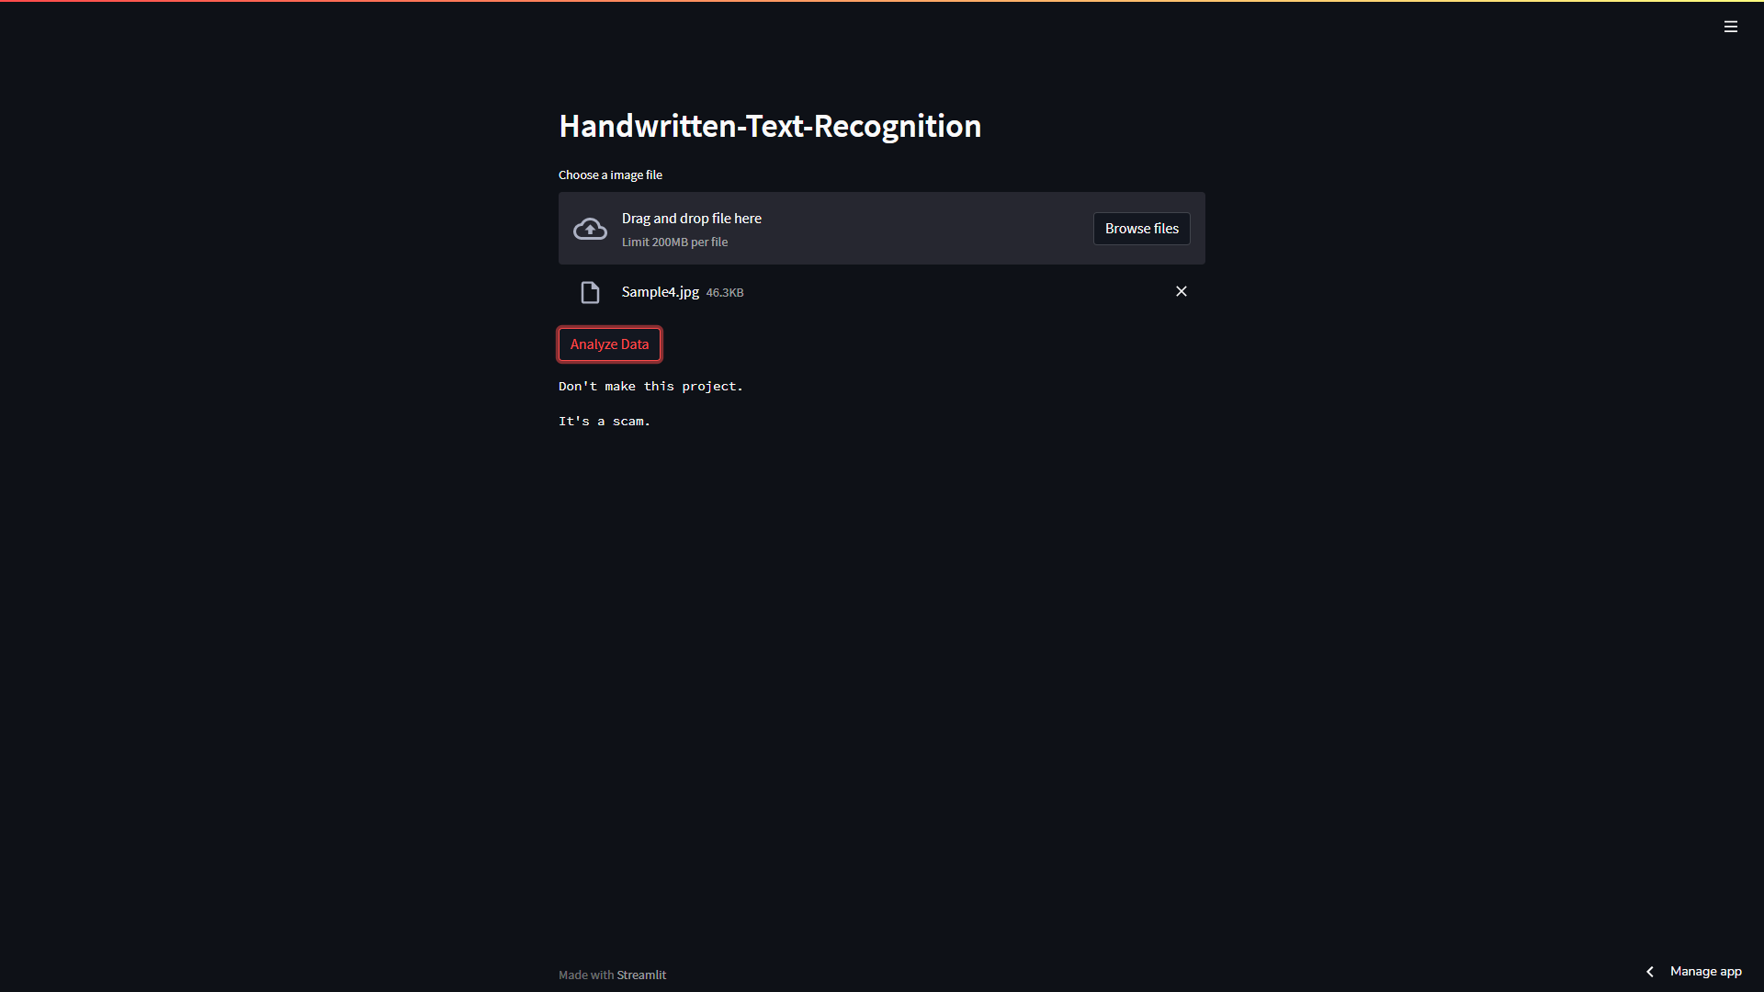

Slide 27
SCOPE

Slide 28
SCOPE
Healthcare and pharmaceuticals: Patient prescription digitization is a major pain point in healthcare/pharmaceutical industry. For example, Roche is handling millions of petabytes of medical PDFs daily. Another area where handwritten text detection has key impact is patient enrollment and form digitization. By adding handwriting recognition to their toolkit of services, hospitals/pharmaceuticals can significantly improve user experience.
Insurance: A large insurance industry receives more than 20 million documents a day and a delay in processing the claim can impact the company terribly. The claims document can contain various different handwriting styles and pure manual automation of processing claims is going to completely slow down the pipeline

Slide 29
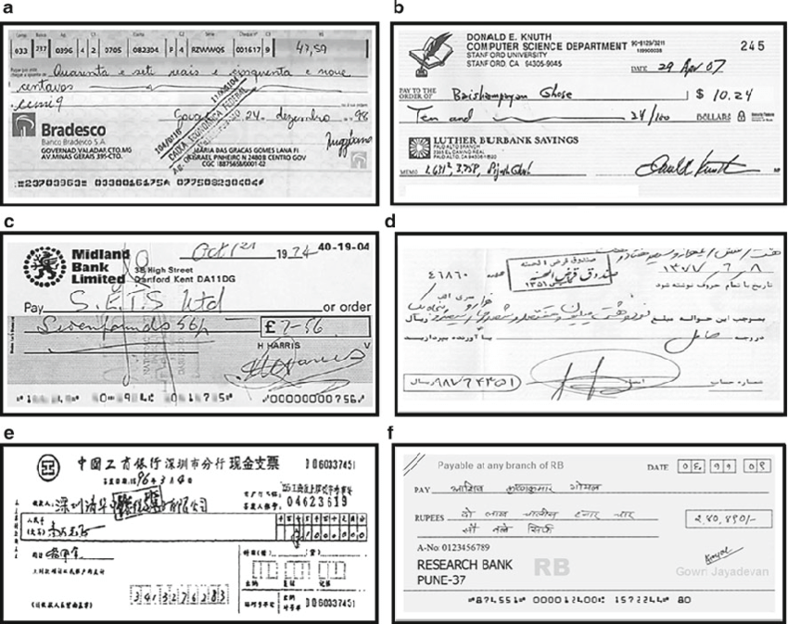

Slide 30
Future Plans
Train with more Data Sets
1
2
Create an App for phone for this model.
Reduce the time complexity by using different algorithms.
3

Slide 31

“Predicting the future isn’t magic, it’s artificial intelligence”

Slide 32

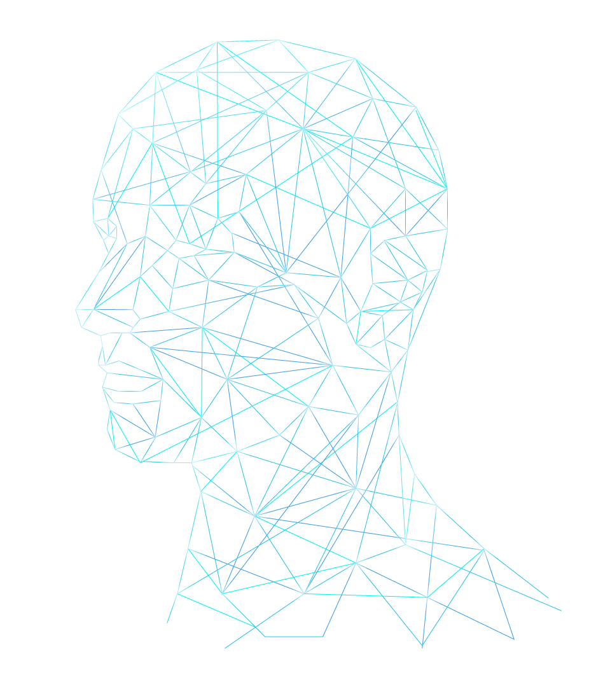
THANKS!

